Slide 1
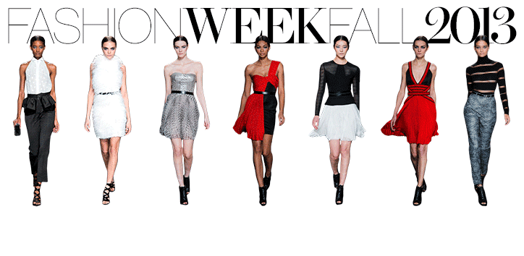
My clothes
By Teacher Mook
Primary 2

Slide 2
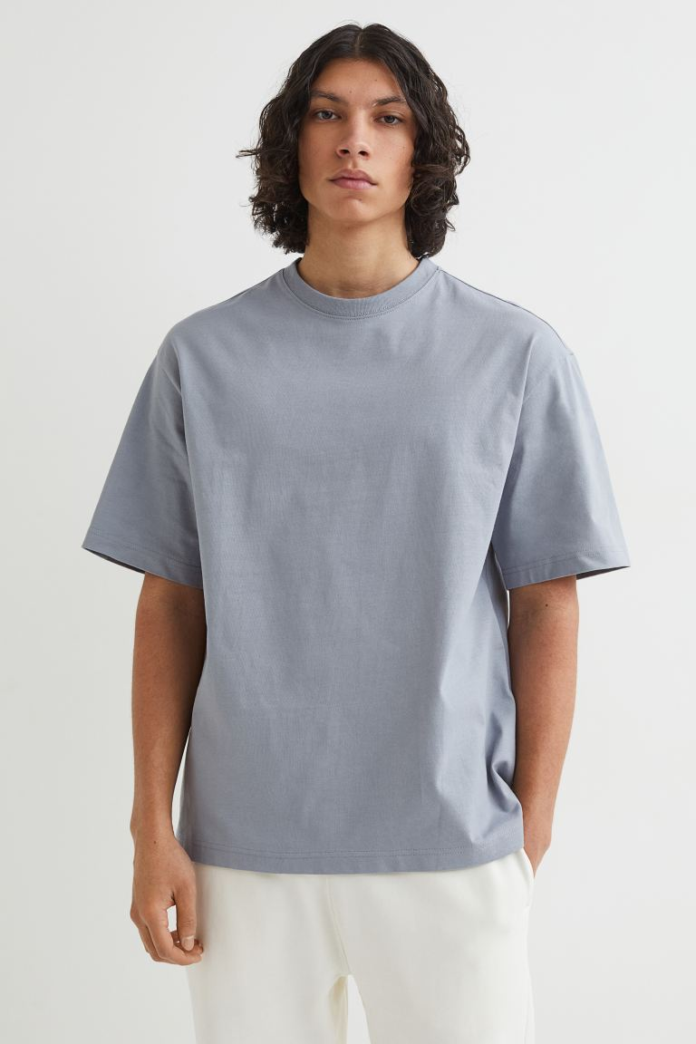
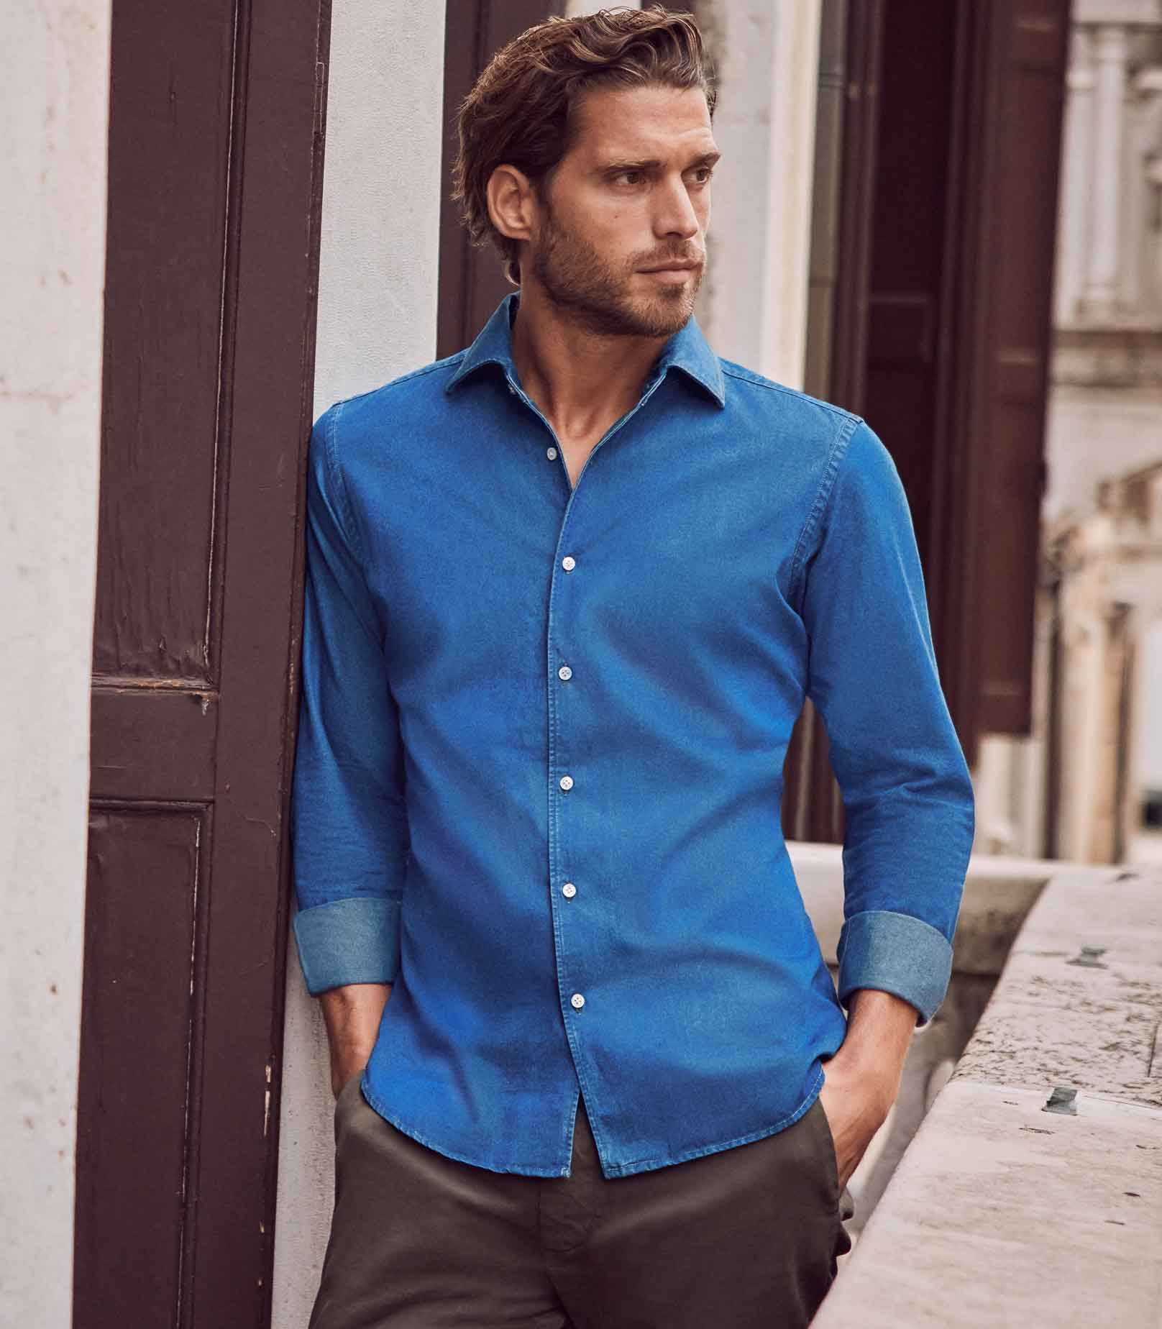
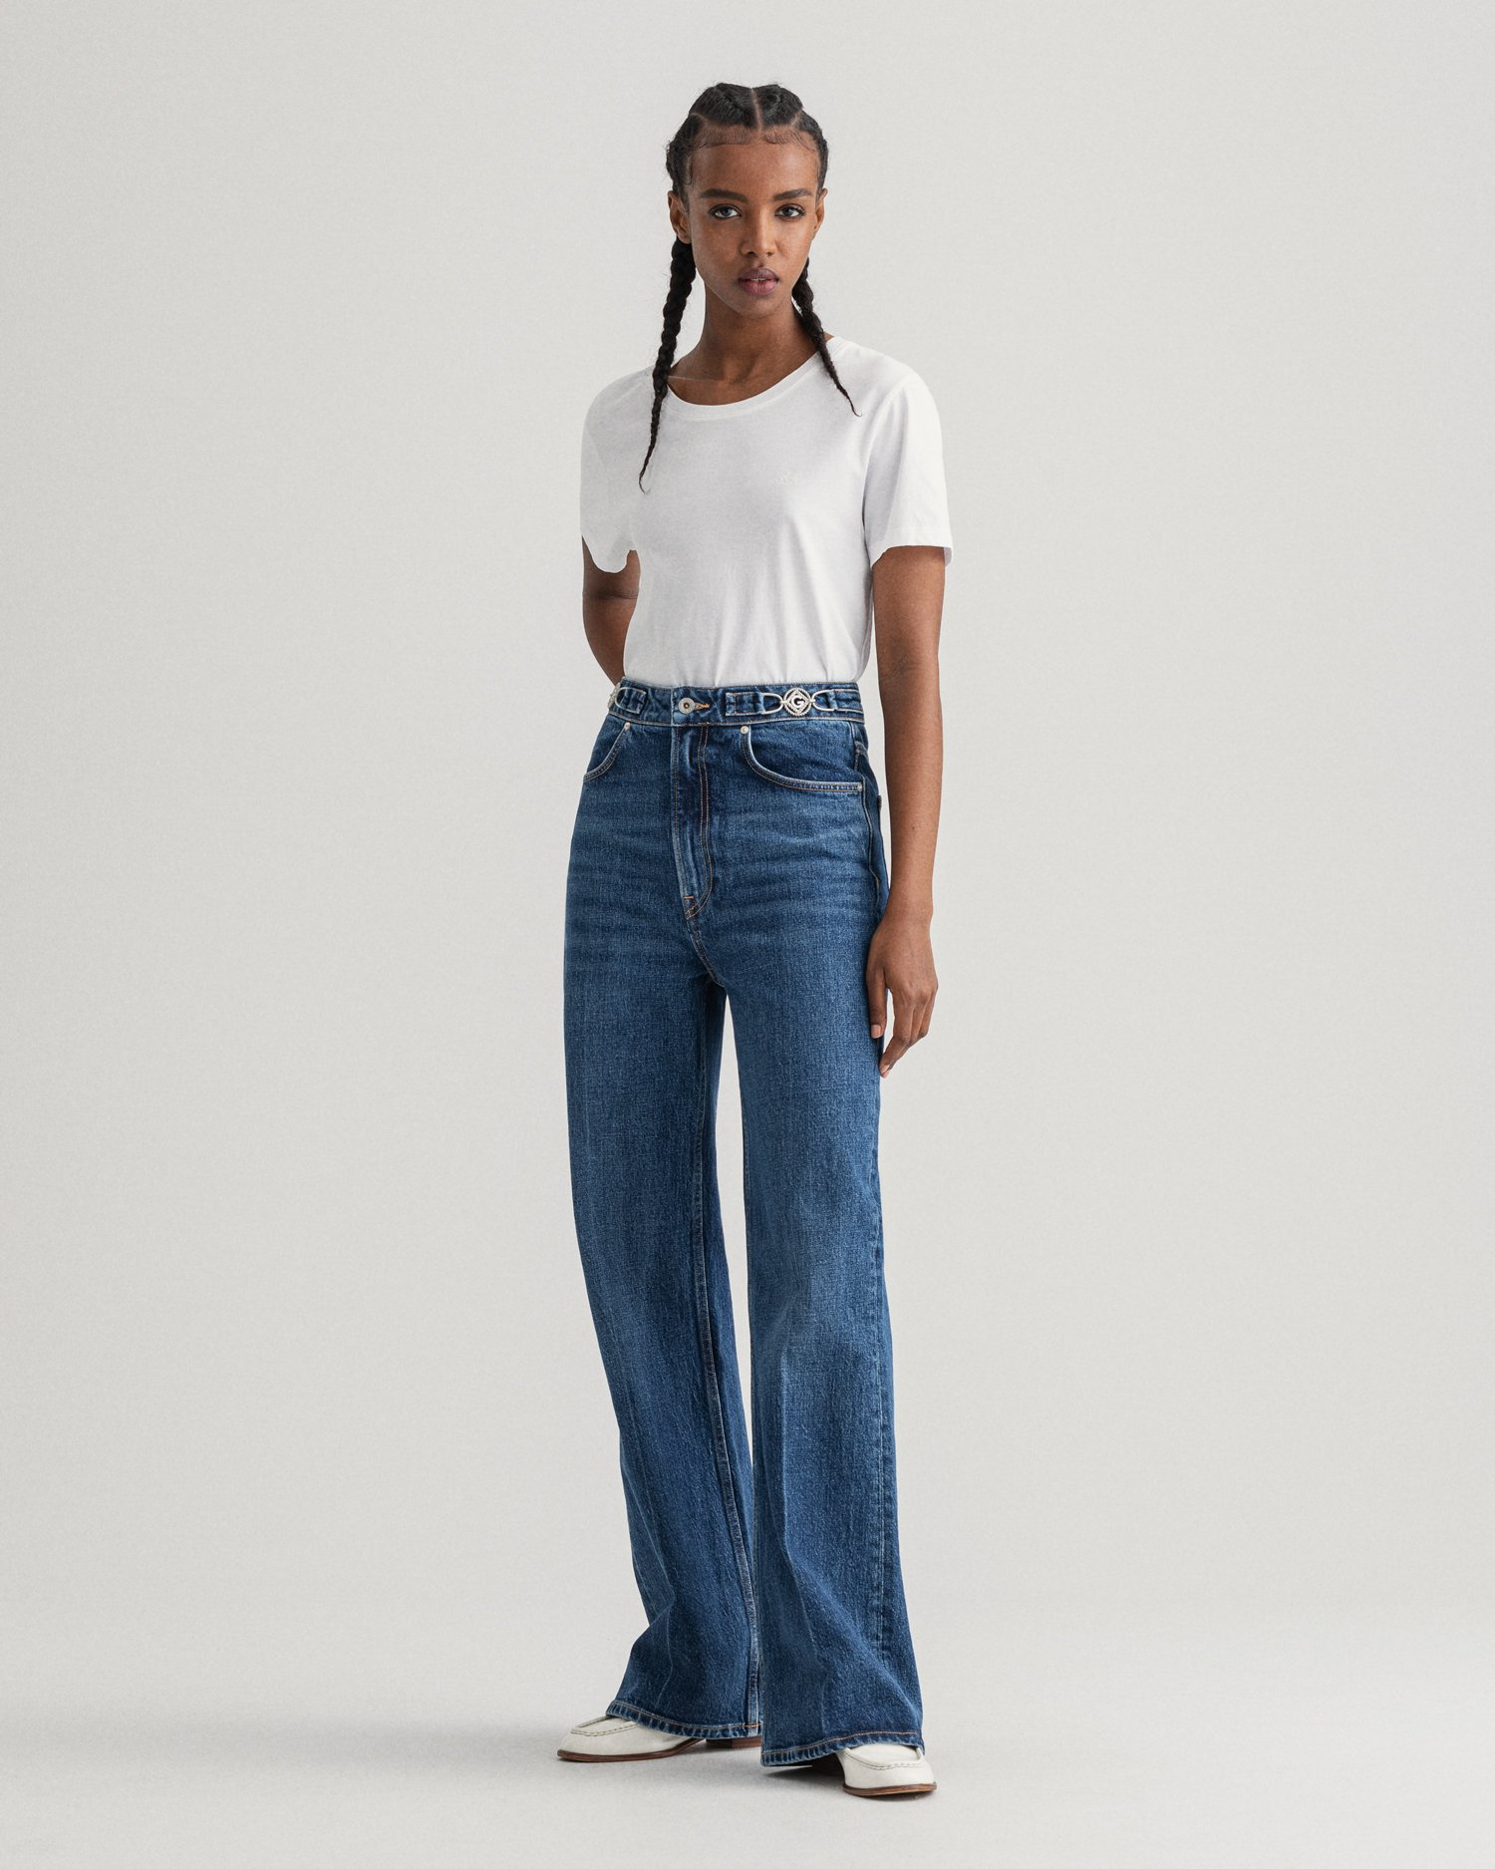
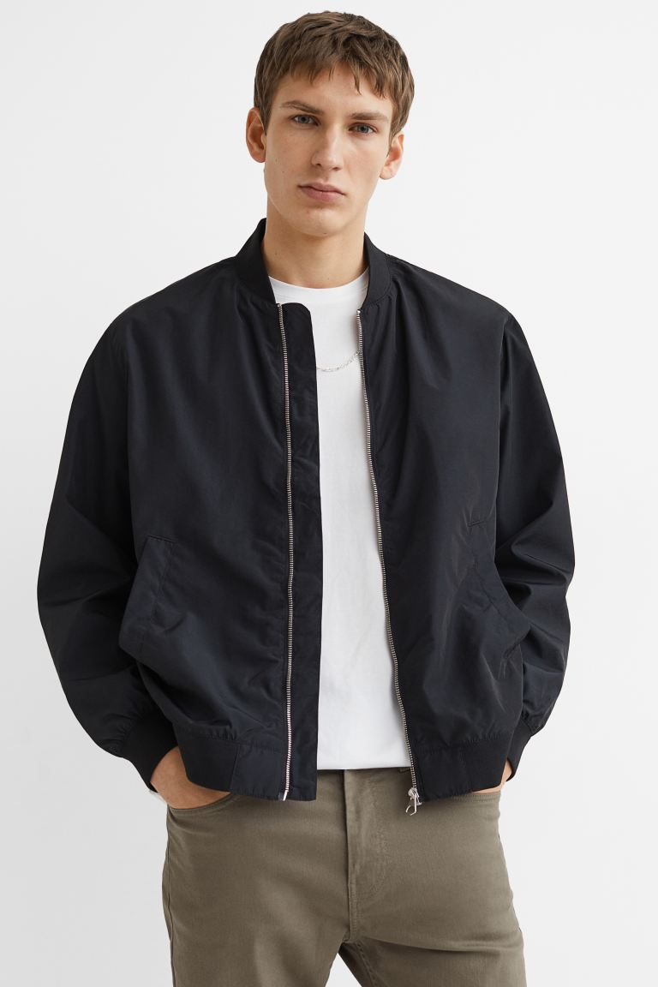
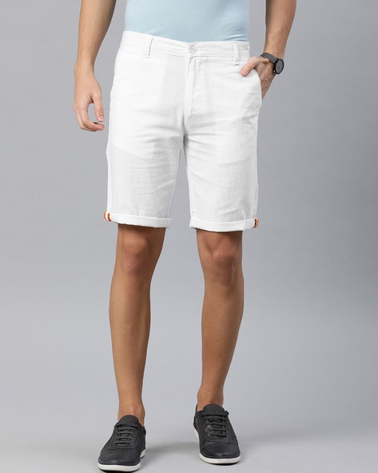
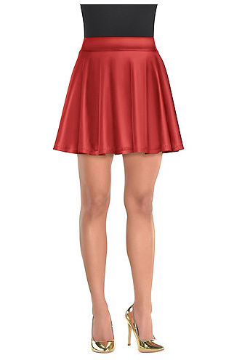
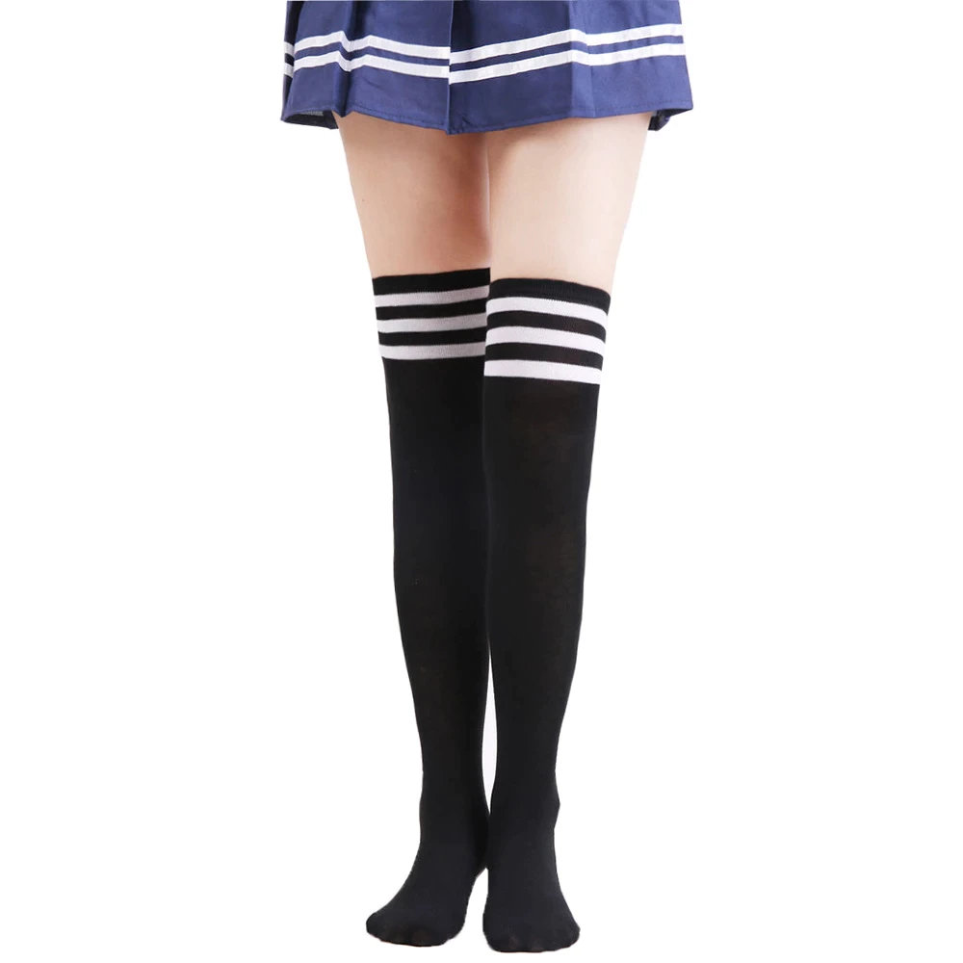
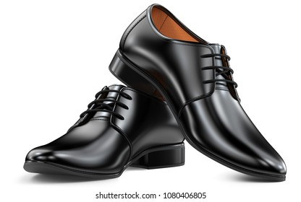
jacket
T-shirt
shirt
jeans
socks
shoes
shorts
skirt

Slide 3
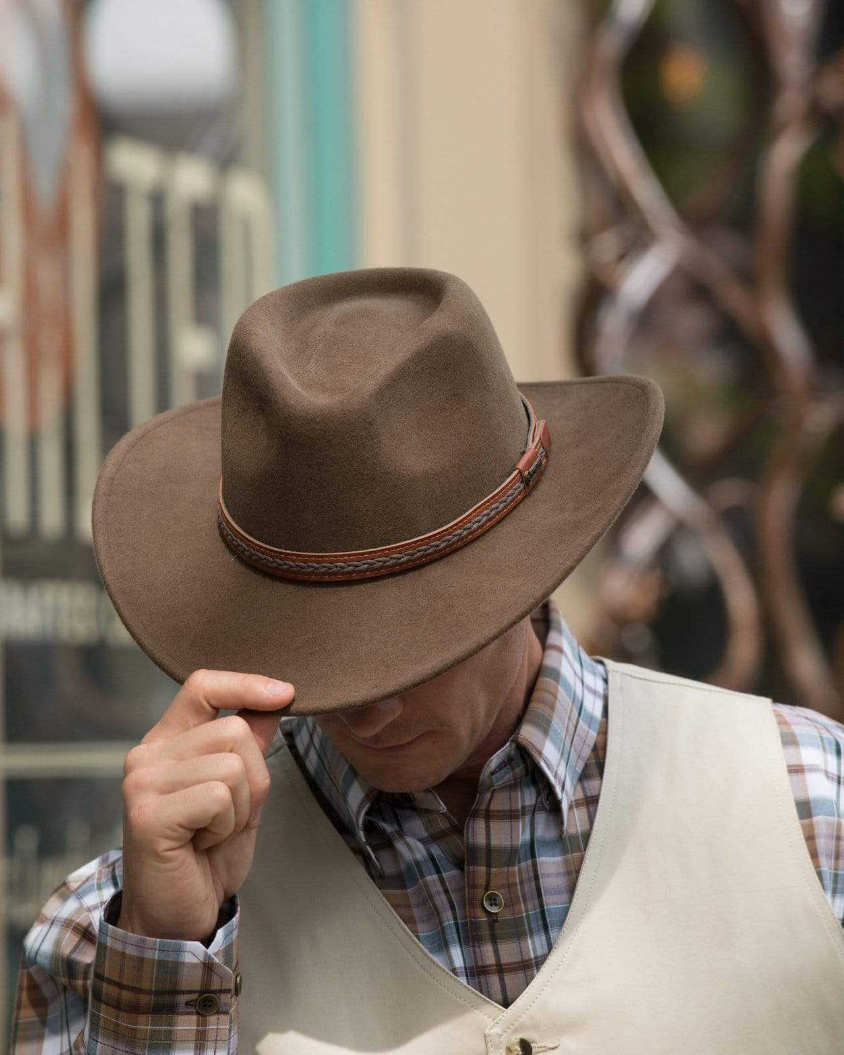
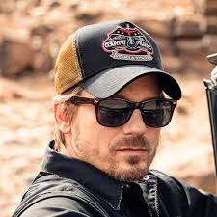
Cap หมวกแก๊ป
I’m wearing a cap..
Hat หมวก
I’m wearing a hat.

Slide 4
shirt (เชิร์ท) เสื้อเชิ้ต
He is wearing a blue shirt.
T-shirt (ที-เชิร์ท) เสื้อยืด
He is wearing a gray t-shirt.

Slide 5
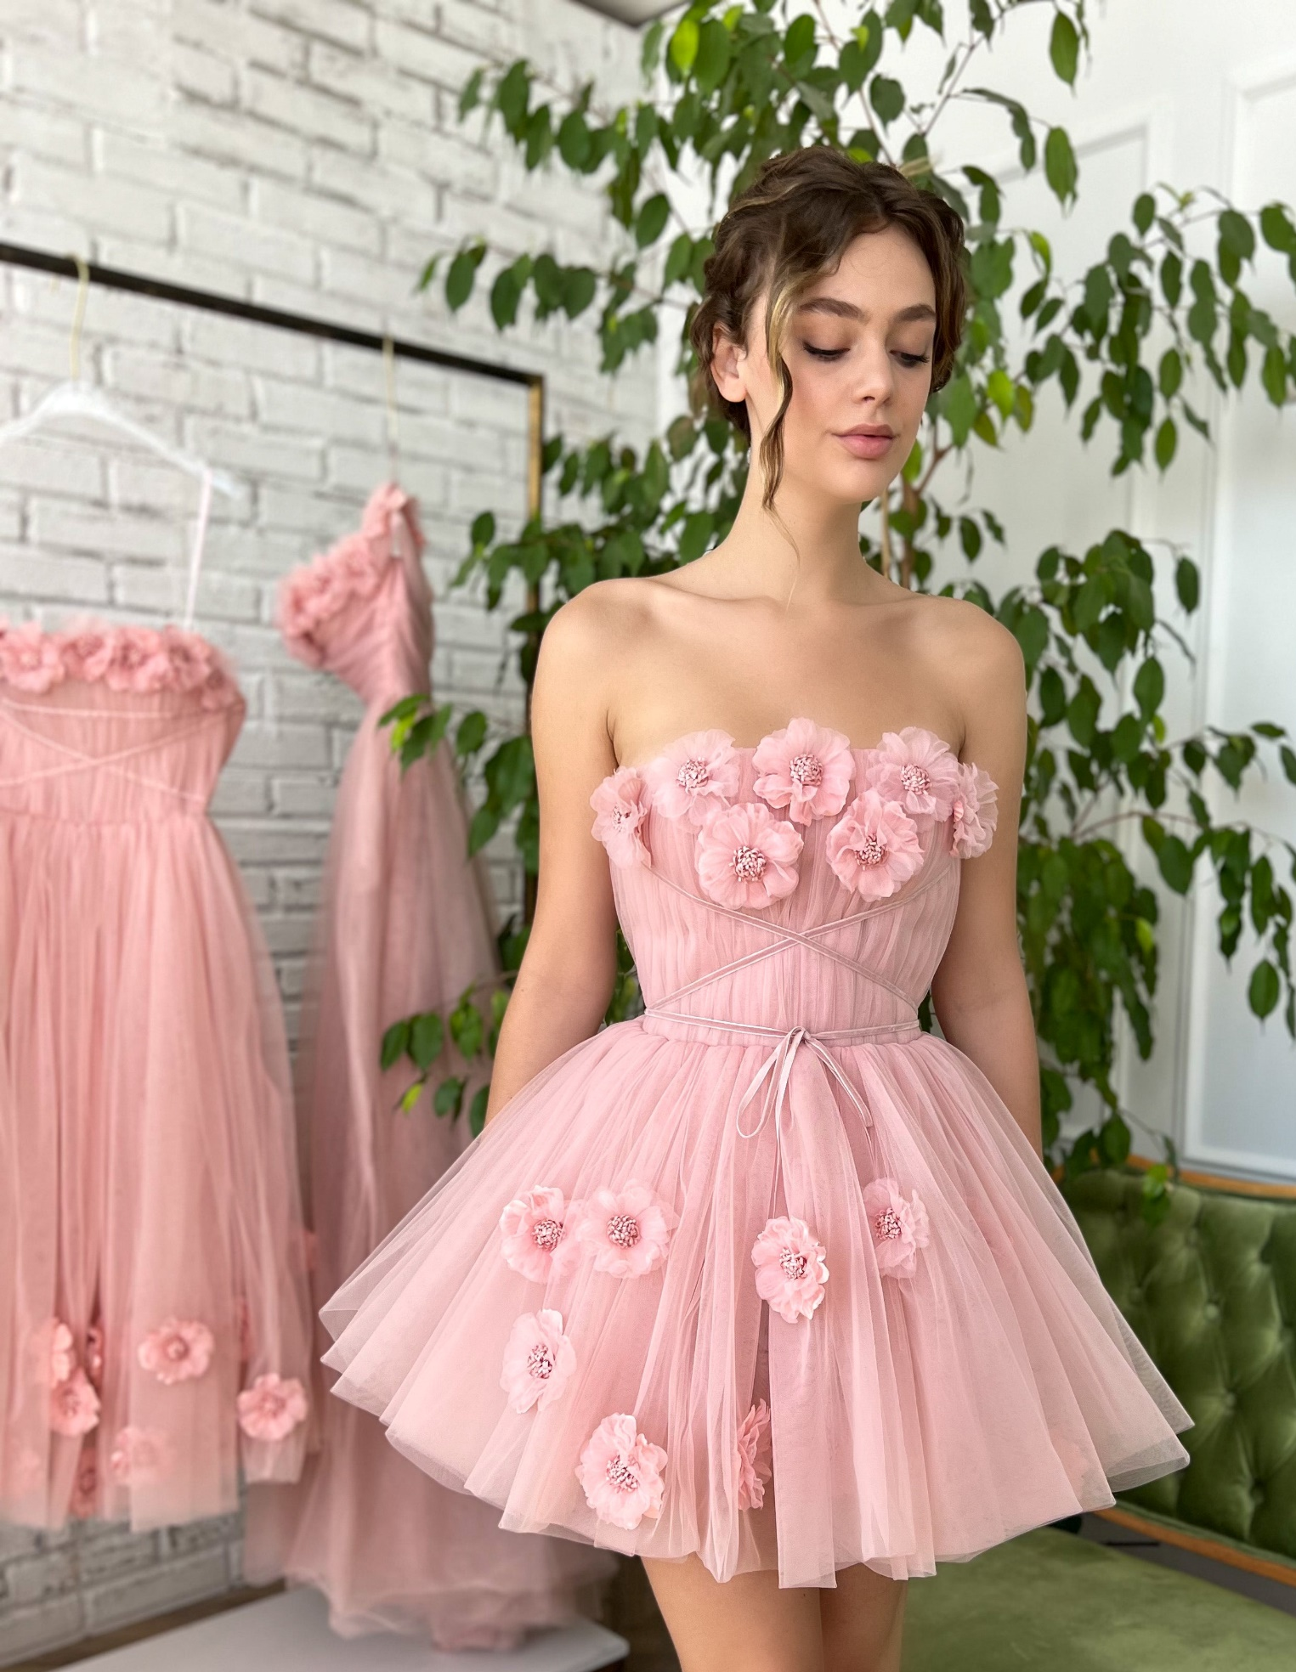
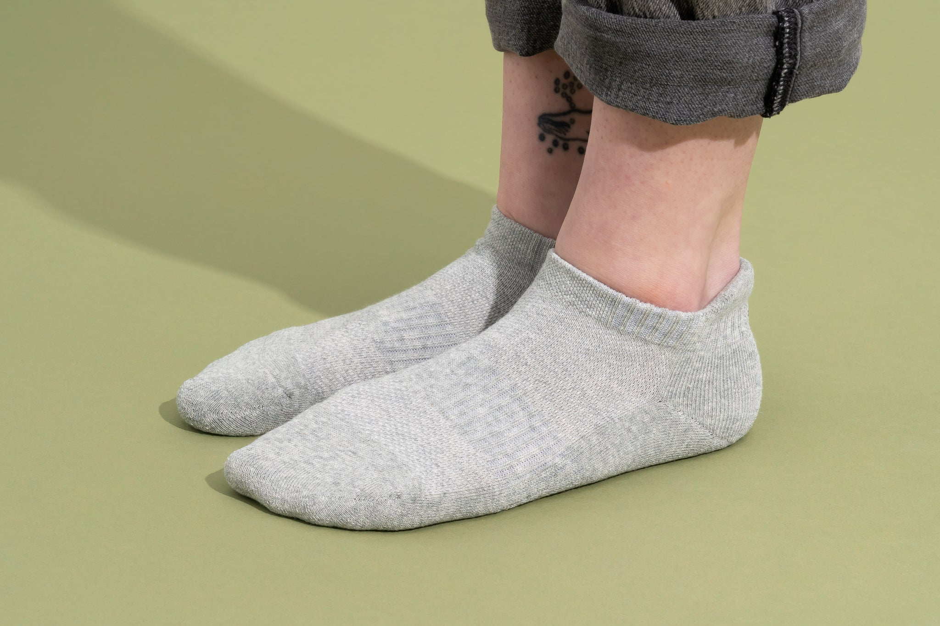
socks (ซอค) ถุงเท้า
My socks are gray.
Dress เดรส
I am wearing a pink dress.

Slide 6
jacket (แจค’เคท)
เสื้อแจ็คเก็ต
He is wearing a black jacket.

Slide 7
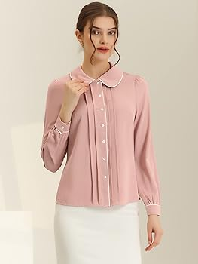
blouse (เบลาส)
เสื้อสตรี
My blouse is pink.

Slide 8
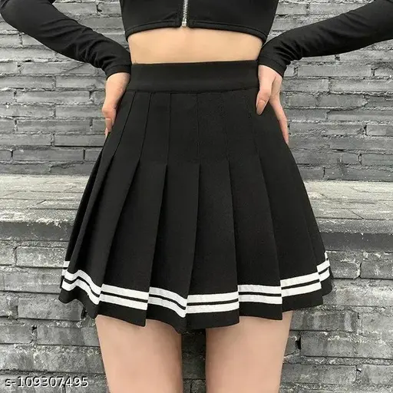
skirt (สเคิร์ท) กระโปรง
She is wearing a black skirt.
jeans (จีนสฺ) กางเกงยีน
She is wearing blue jeans.

Slide 9
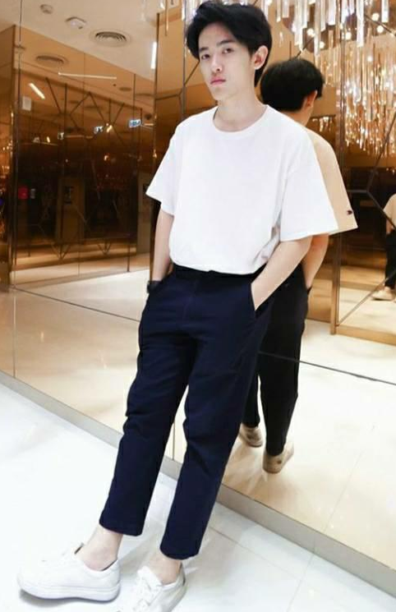
trousers กางเกงขายาว
He is wearing trousers.
shorts (ชอร์ท) กางเกงขาสั้น
He is wearing white shorts.

Slide 10
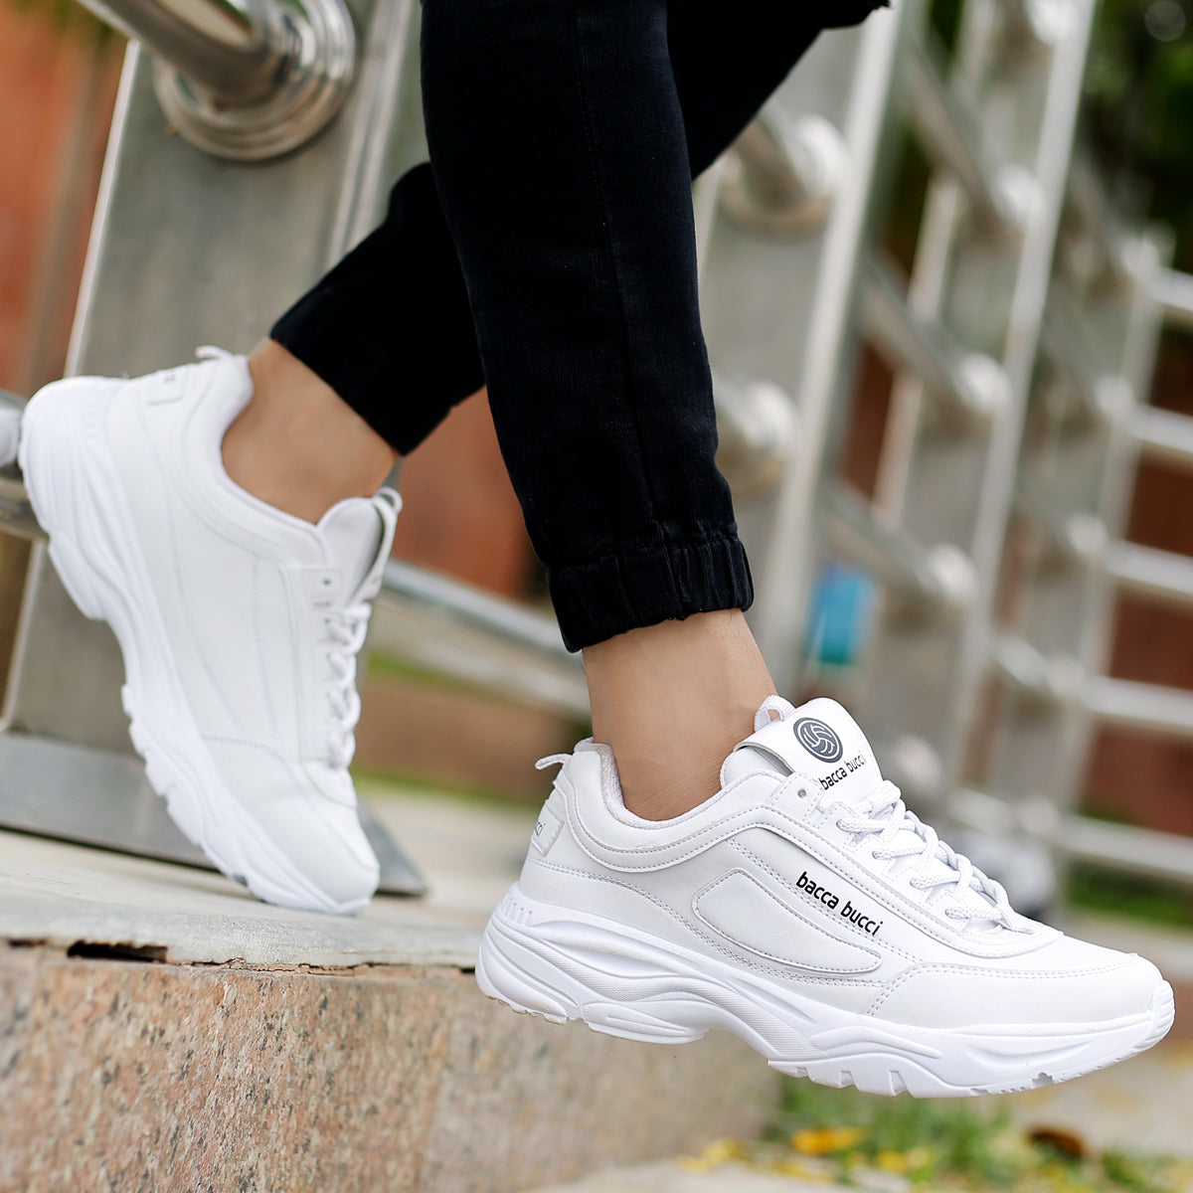
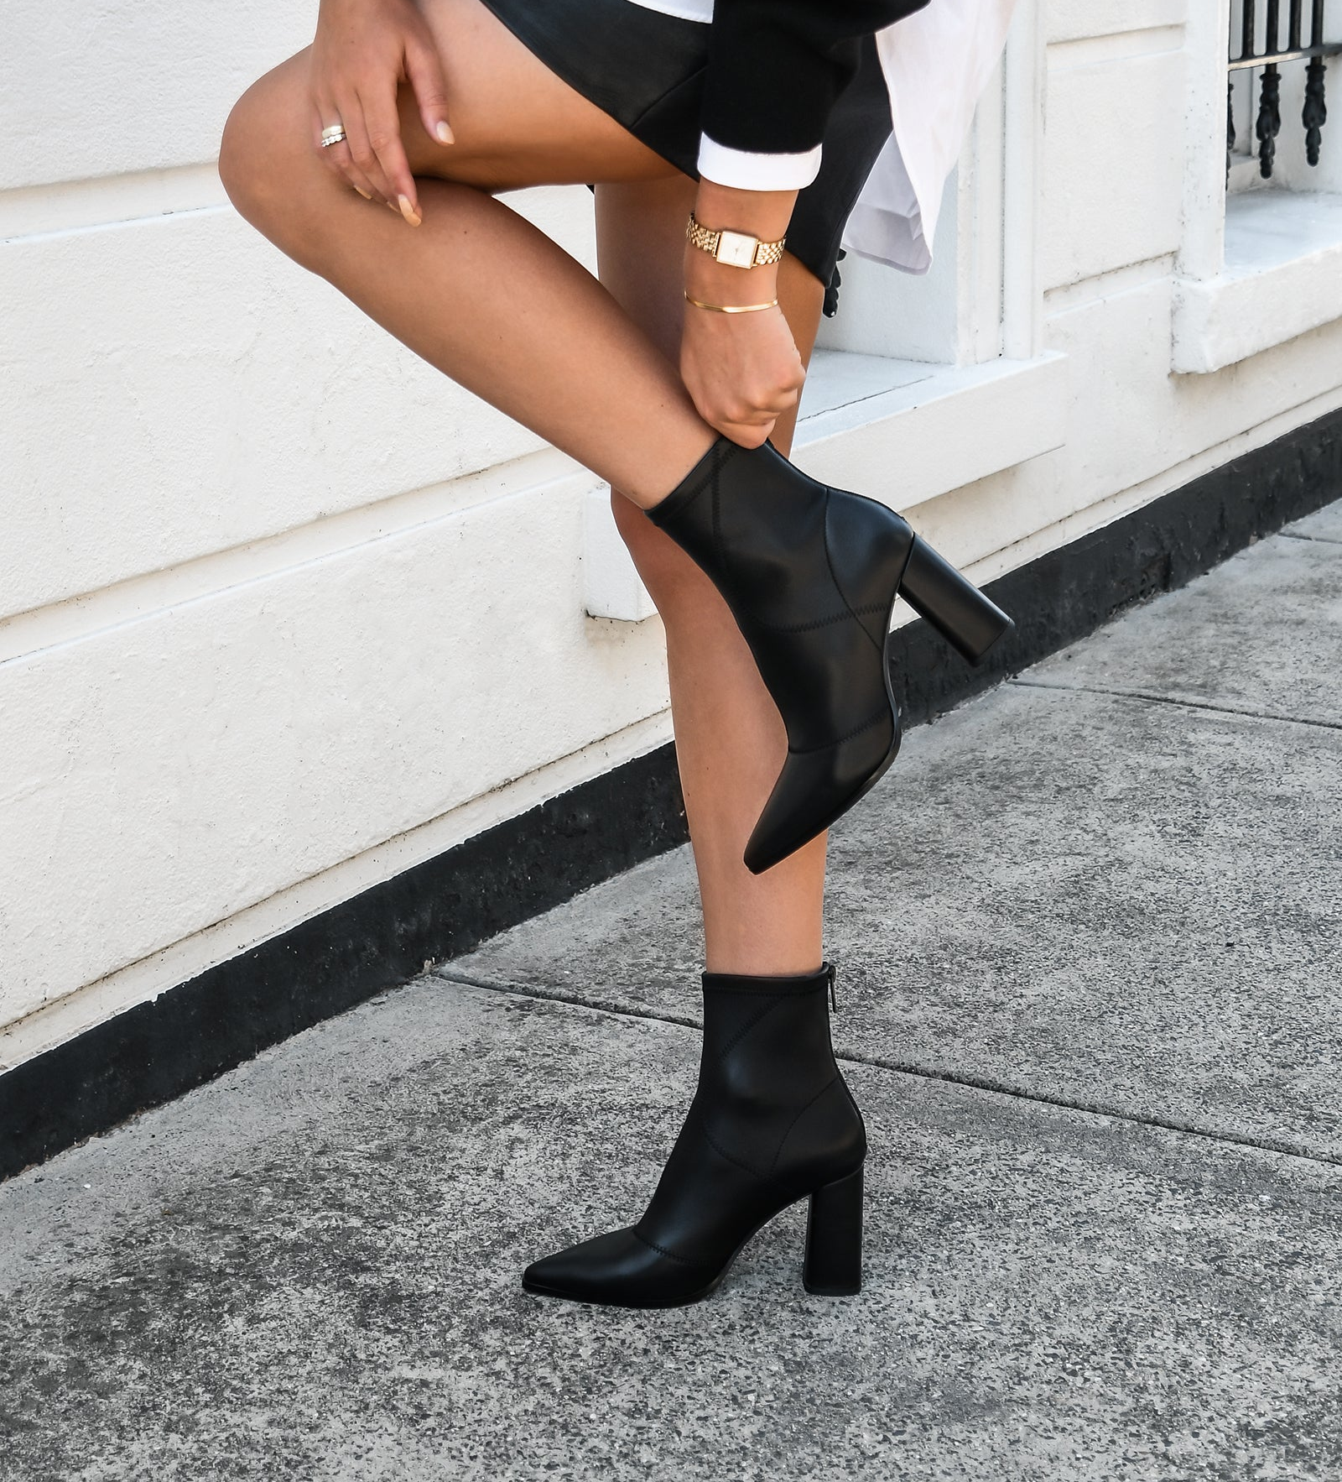
Boots รองเท้าหุ้มส้น
I’m wearing black boots..
Shoes รองเท้า
I’m wearing white shoes.

Slide 11


shirt
T-shirt
skirt
cap
jeans
dress
blouse
shoes
cap
milk tea

Slide 12



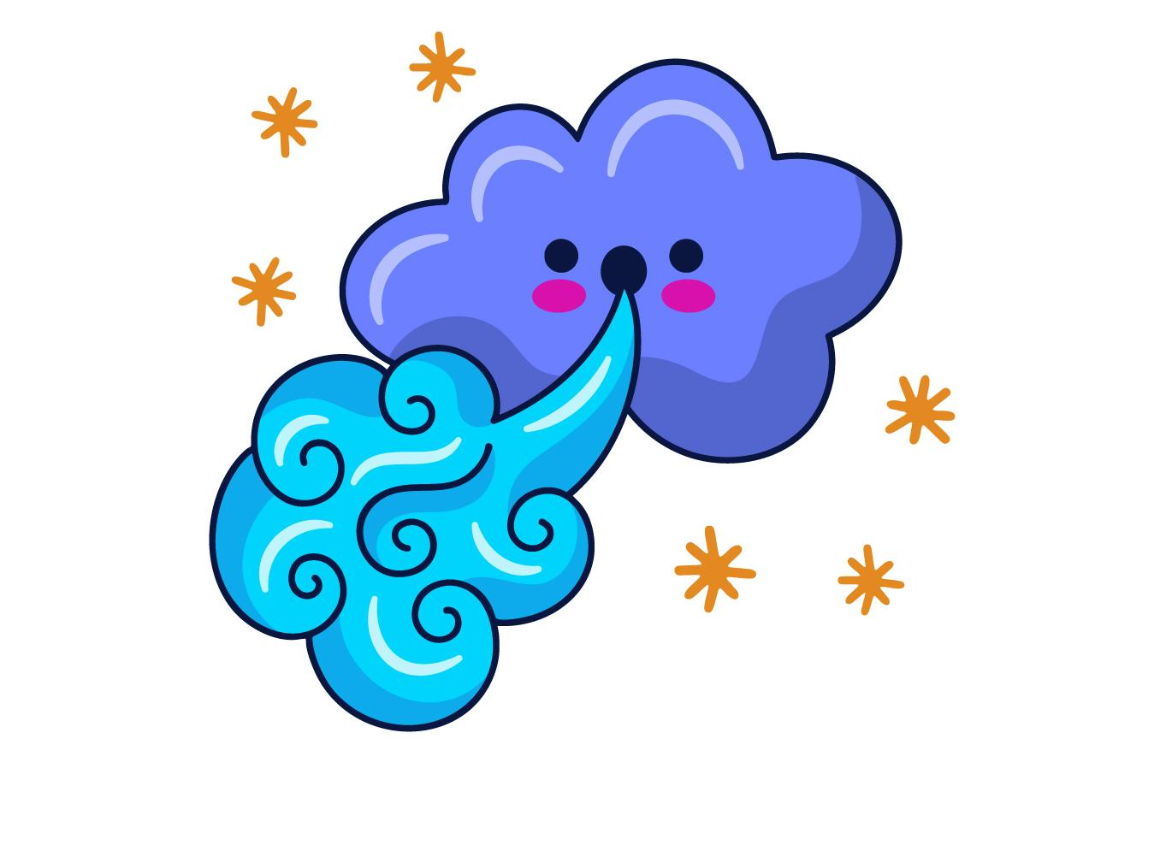



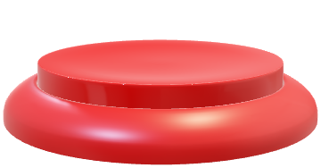
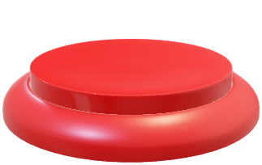
Can you guess?
1
2
3
4
5
6
7
windy
8
9
10
11
12
13
14
15
16
17
18
19
20
21
6
22
23
24
25
26
27
28
Key
Vocabulary
29
30
31
32
33
34
35
36
37
38
39
40
41
42

Slide 13
Can you guess?
1
2
3
4
5
6
7
windy
8
9
10
11
12
13
14
15
16
17
18
19
20
21
6
22
23
24
25
26
27
28
Key
Vocabulary
29
30
31
32
33
34
35
36
37
38
39
40
41
42

Slide 14
Can you guess?
1
2
3
4
5
6
7
windy
8
9
10
11
12
13
14
15
16
17
18
19
20
21
6
22
23
24
25
26
27
28
Key
Vocabulary
29
30
31
32
33
34
35
36
37
38
39
40
41
42

Slide 15
Can you guess?
1
2
3
4
5
6
7
windy
8
9
10
11
12
13
14
15
16
17
18
19
20
21
6
22
23
24
25
26
27
28
Key
Vocabulary
29
30
31
32
33
34
35
36
37
38
39
40
41
42

Slide 16
Can you guess?
1
2
3
4
5
6
7
windy
8
9
10
11
12
13
14
15
16
17
18
19
20
21
6
22
23
24
25
26
27
28
Key
Vocabulary
29
30
31
32
33
34
35
36
37
38
39
40
41
42

Slide 17
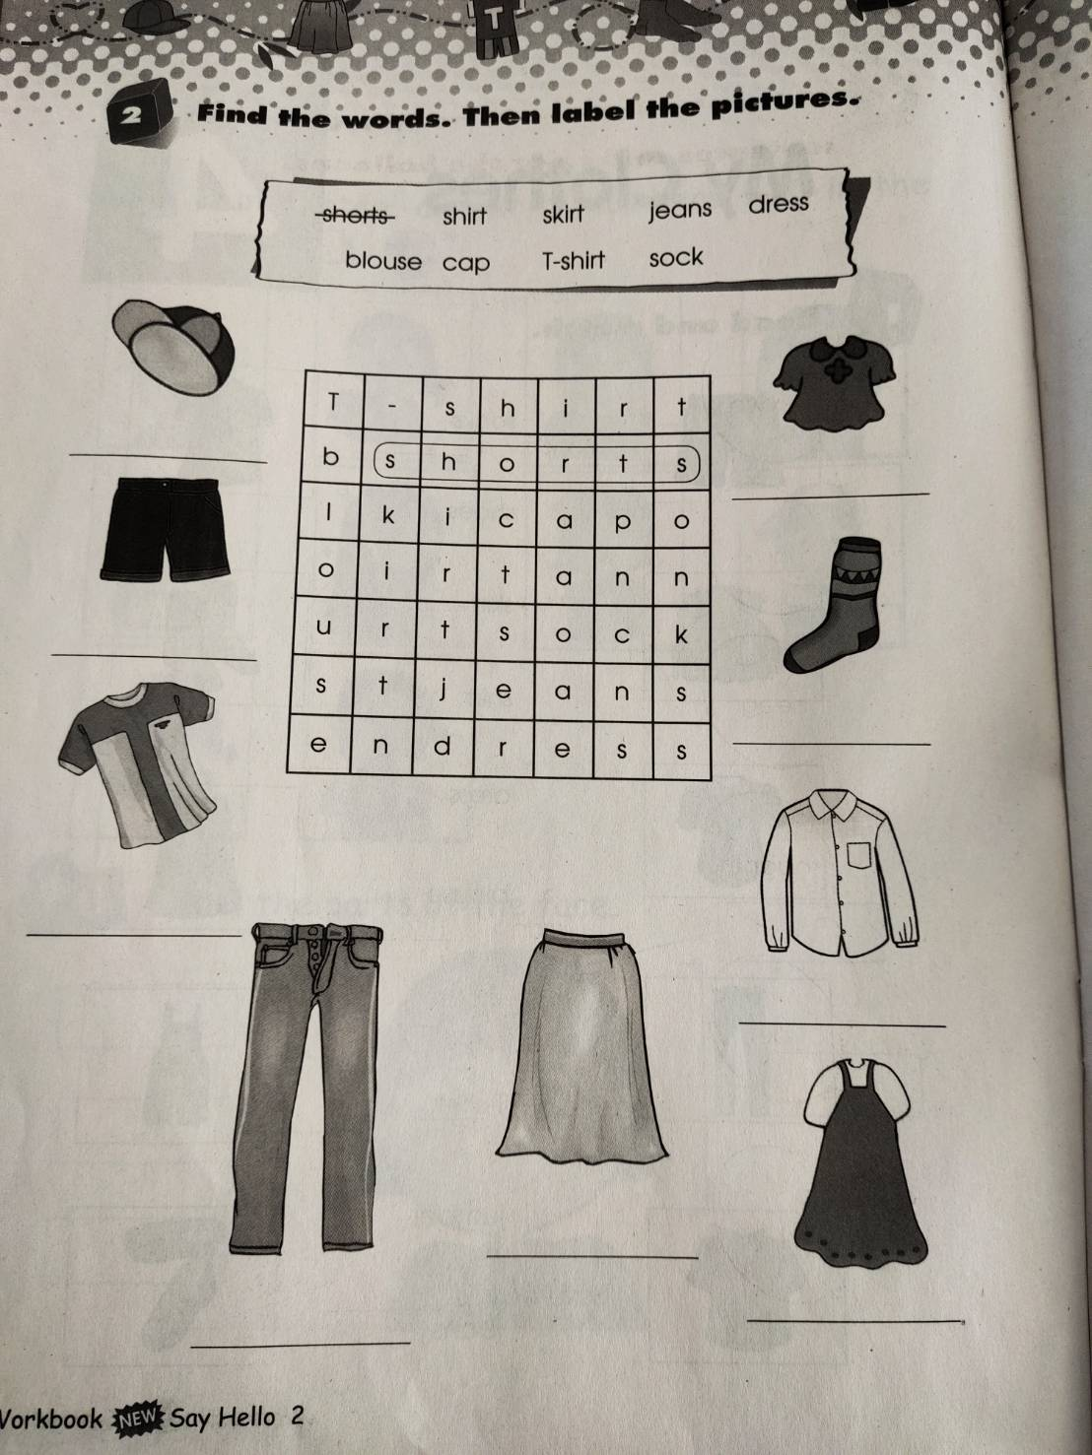
Page 28

Slide 18
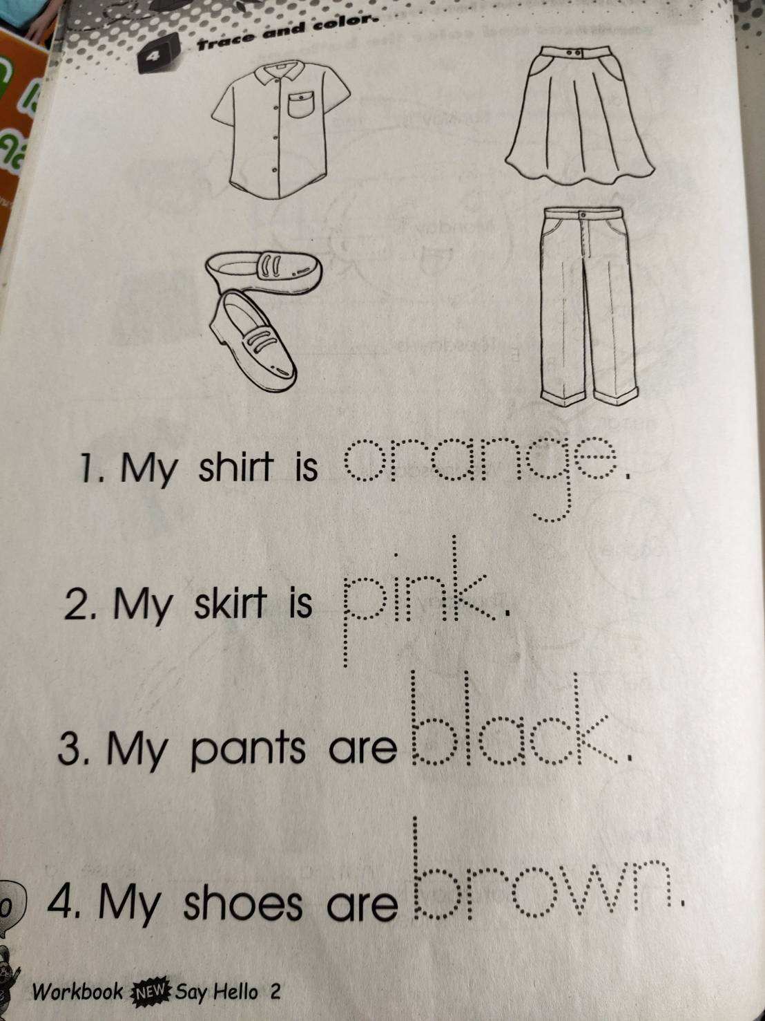
Page 30

Slide 19
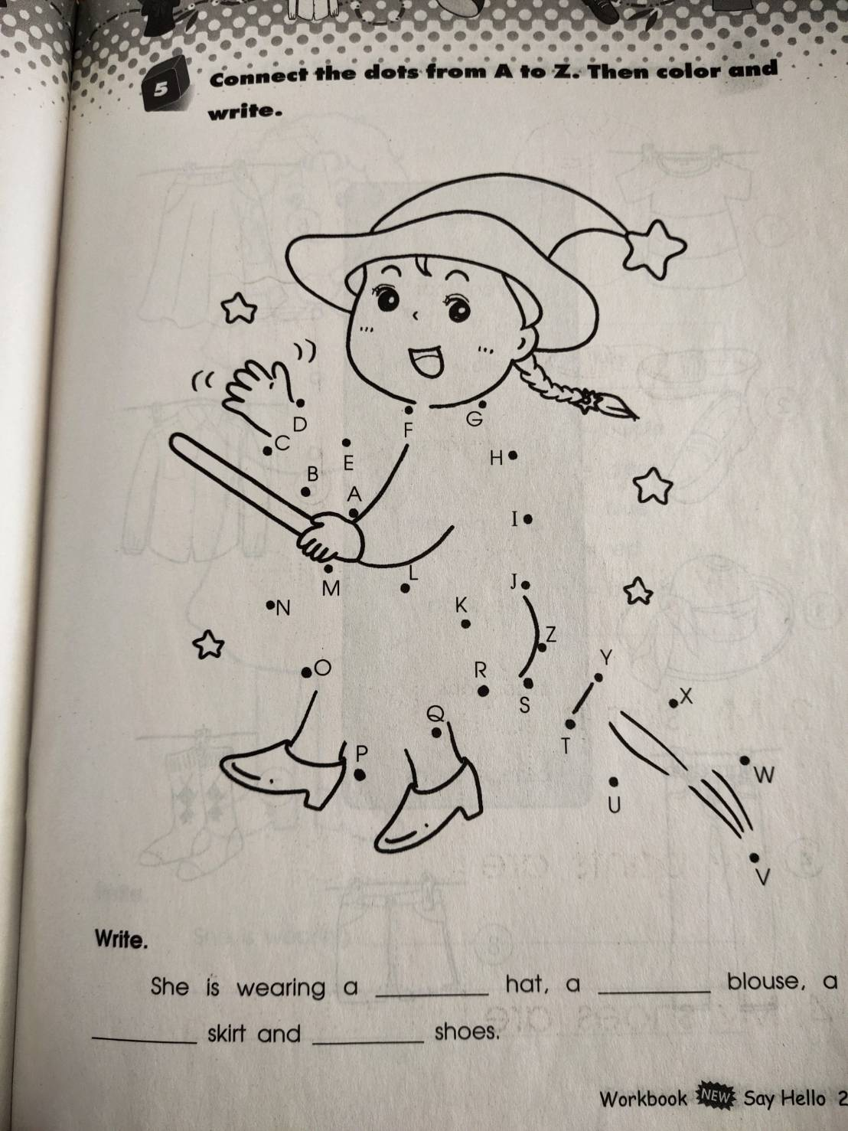
Page 31

Slide 20
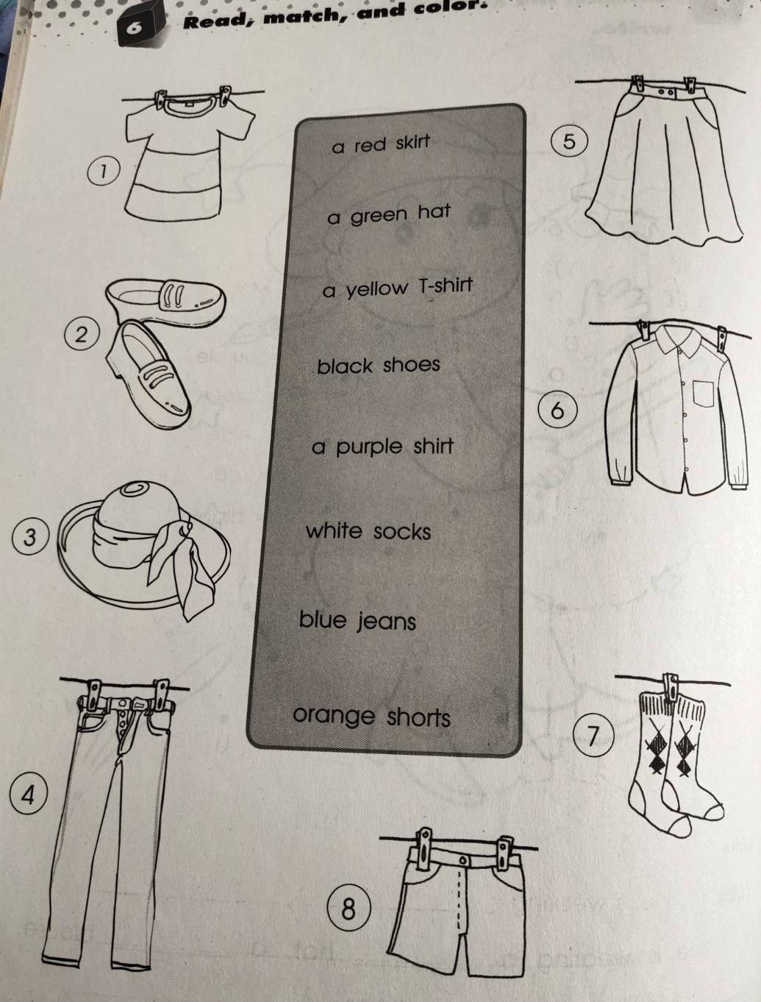
Page 32

Slide 21
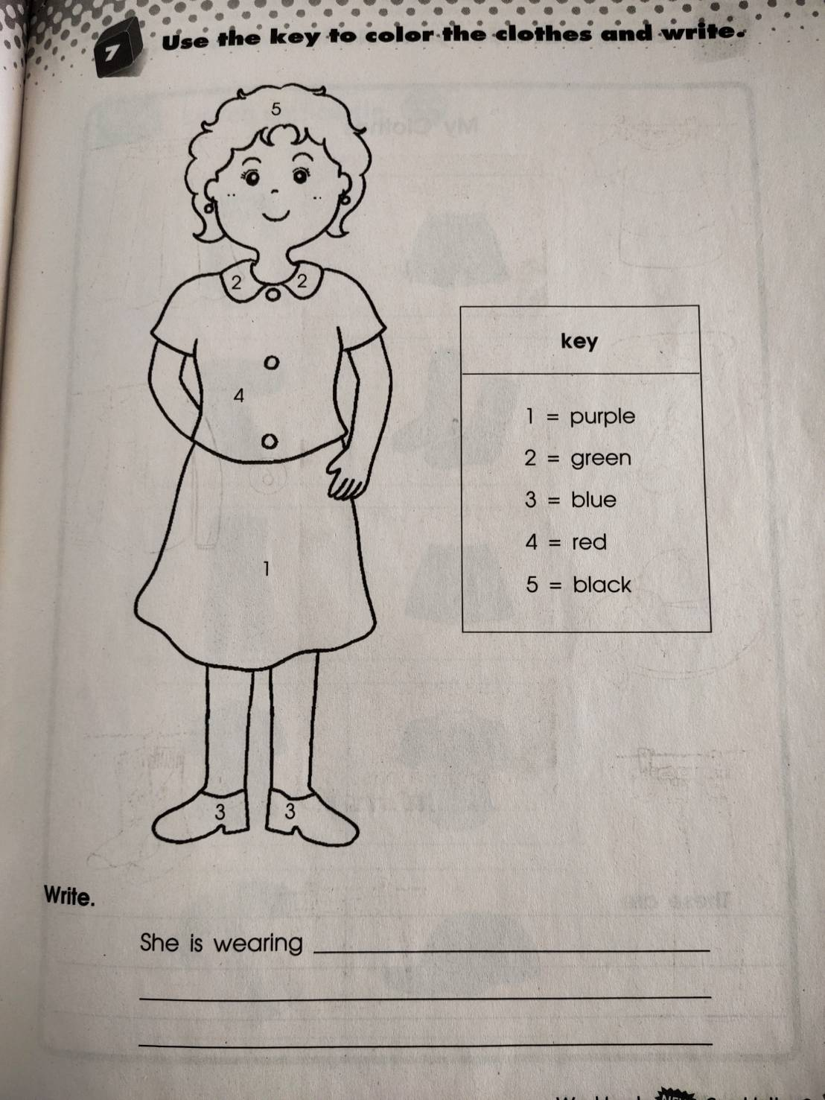
Page 33

Slide 22
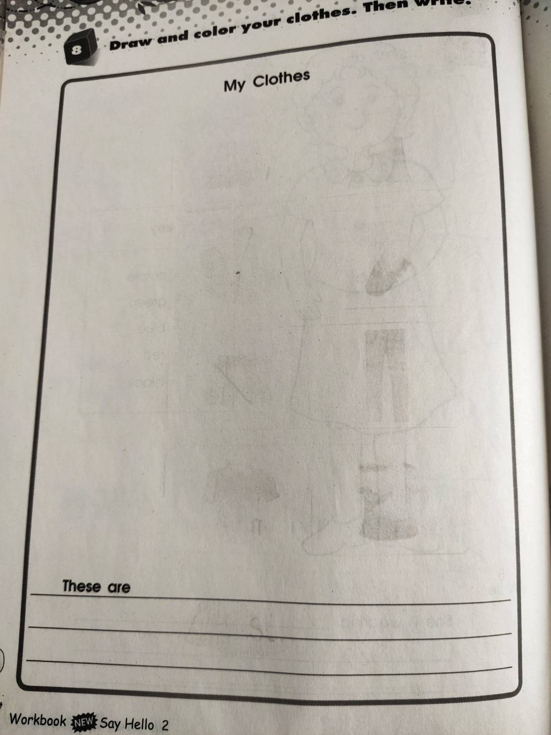


































Page 34
There are my clothes.
My shirt is pink.
My shorts are red.
My shores are yellow.

Slide 23
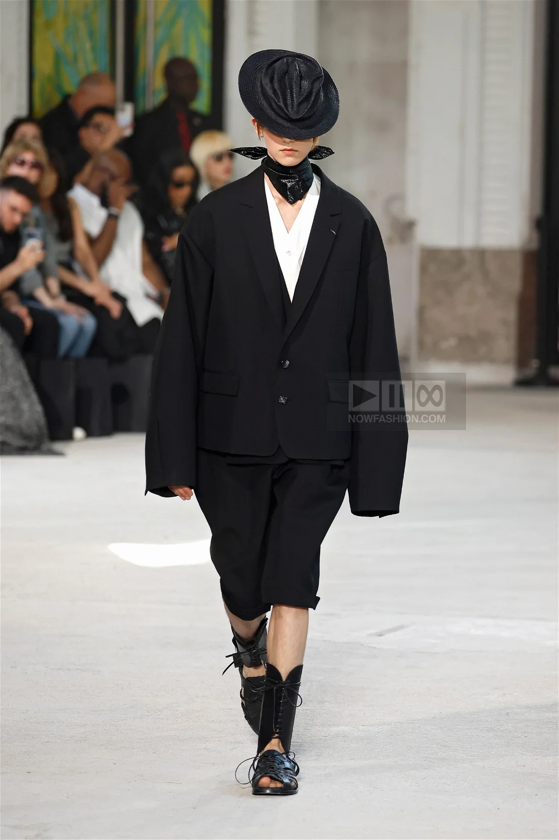
Hat
suit
shorts
shoes

Slide 24
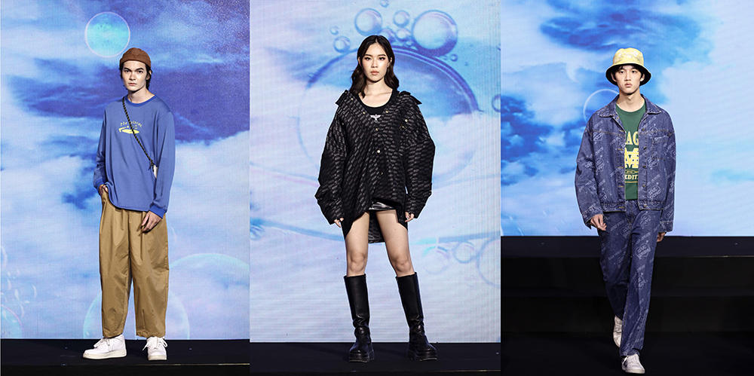
Hat
T-shirt
jacket
trousers
shoes

Slide 25
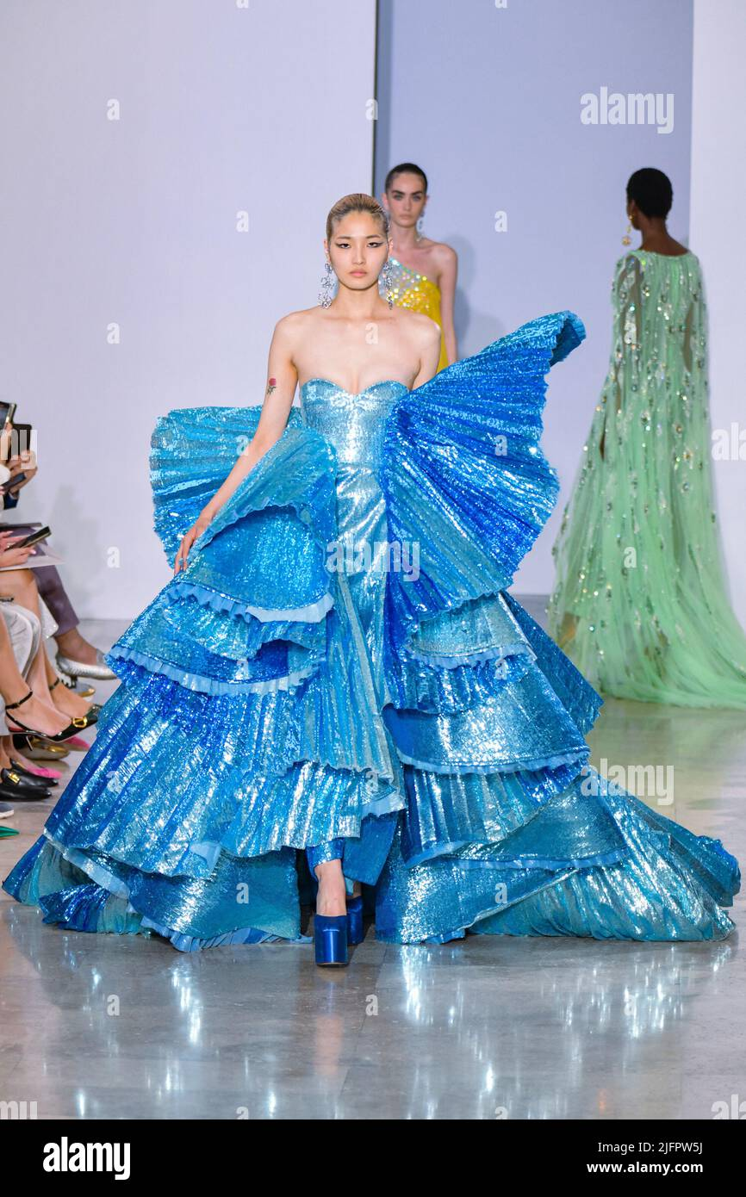
Hat
T-shirt
jacket
trousers
shoes

Slide 26
Can you guess?
1
2
3
4
5
6
7
windy
8
9
10
11
12
13
14
15
16
17
18
19
20
21
6
22
23
24
25
26
27
28
Key
Vocabulary
29
30
31
32
33
34
35
36
37
38
39
40
41
42

Slide 27
Can you guess?
1
2
3
4
5
6
7
windy
8
9
10
11
12
13
14
15
16
17
18
19
20
21
6
22
23
24
25
26
27
28
Key
Vocabulary
29
30
31
32
33
34
35
36
37
38
39
40
41
42

Slide 28
Can you guess?
1
2
3
4
5
6
7
windy
8
9
10
11
12
13
14
15
16
17
18
19
20
21
6
22
23
24
25
26
27
28
Key
Vocabulary
29
30
31
32
33
34
35
36
37
38
39
40
41
42

Slide 29
Can you guess?
1
2
3
4
5
6
7
windy
8
9
10
11
12
13
14
15
16
17
18
19
20
21
6
22
23
24
25
26
27
28
Key
Vocabulary
29
30
31
32
33
34
35
36
37
38
39
40
41
42

Slide 30
Can you guess?
1
2
3
4
5
6
7
windy
8
9
10
11
12
13
14
15
16
17
18
19
20
21
6
22
23
24
25
26
27
28
Key
Vocabulary
29
30
31
32
33
34
35
36
37
38
39
40
41
42

Slide 31
Can you guess?
1
2
3
4
5
6
7
windy
8
9
10
11
12
13
14
15
16
17
18
19
20
21
6
22
23
24
25
26
27
28
Key
Vocabulary
29
30
31
32
33
34
35
36
37
38
39
40
41
42

Slide 32
Can you guess?
1
2
3
4
5
6
7
windy
8
9
10
11
12
13
14
15
16
17
18
19
20
21
6
22
23
24
25
26
27
28
Key
Vocabulary
29
30
31
32
33
34
35
36
37
38
39
40
41
42

Slide 33
Can you guess?
1
2
3
4
5
6
7
windy
8
9
10
11
12
13
14
15
16
17
18
19
20
21
6
22
23
24
25
26
27
28
Key
Vocabulary
29
30
31
32
33
34
35
36
37
38
39
40
41
42

